Slide 1

Space Invaders Project
A simple arcade-style shooter built with Python/Pygame
Team Members: Madhusuthan , Naonith K Rao , Abhinav MB , Likhith B
Batch No: 16

Slide 2
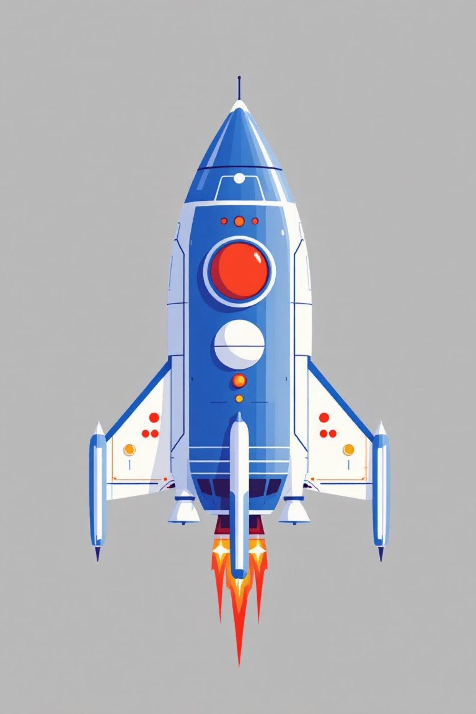
Problem Statement
1
2
Interactive Arcade Clone
Fundamental Learning
Our objective was to create an engaging arcade game clone that demonstrates core game development principles, such as robust game loops, precise collision detection, efficient sprite management, and intuitive user input handling.
This project served as a practical exercise in learning game development fundamentals, applying Object-Oriented Programming (OOP) concepts, and managing real-time input for an interactive user experience.
3
Key Constraints & Goals
We aimed for cross-platform playability, simple and responsive controls, a smooth frame rate for an enjoyable experience, and a modular code architecture for ease of maintenance and future expansion.

Slide 3




System / Block Diagram
Input Layer
Keyboard and mouse events
Persistence
Game System Flow
Game Engine
High-score and state storage
Game loop, events, collisions
Entities
Rendering
Player, enemies, projectiles
Sprite manager and UI/HUD
Input Layer
Game Engine
Rendering
Keyboard / Mouse
Game loop, Event handling, Collision system
Sprite manager, UI/HUD
Entities
Persistence
Player, Enemies, Projectiles
High-score storage

Slide 4
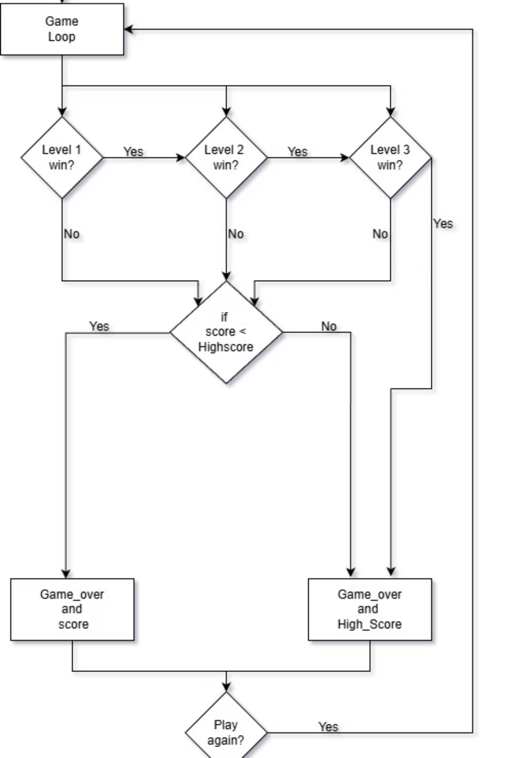
This block diagram explains the flow of our Space Invaders game:
Player starts at the Main Menu and enters the Game Loop.
The player must clear Level 1 → Level 2
If the player fails any level, the game ends and shows the score.
After finishing all levels, the game checks if the score beats the High Score.
Depending on the result, either Game Over with Score or Game Over with High Score is displayed.
The player is then asked whether they want to Play Again or Exit.

Slide 5
Contribution of Team Members
Abhinav MB
PES2UG25AM145
main loop, assets, integrating all the modules
Likith B
PES2UG25AM143
player logic, collision mechanics and bullet logic
Naonith K Rao
PES2UG25CS324
Level design, testing, enemies.py
Madhusuthan V
PES2UG25AM148
UI/HUD, implementation and code testing
Our collaborative approach, utilising Git for version control and regular pull requests, ensured seamless integration of individual contributions and maintained code quality throughout the development cycle.

Slide 6
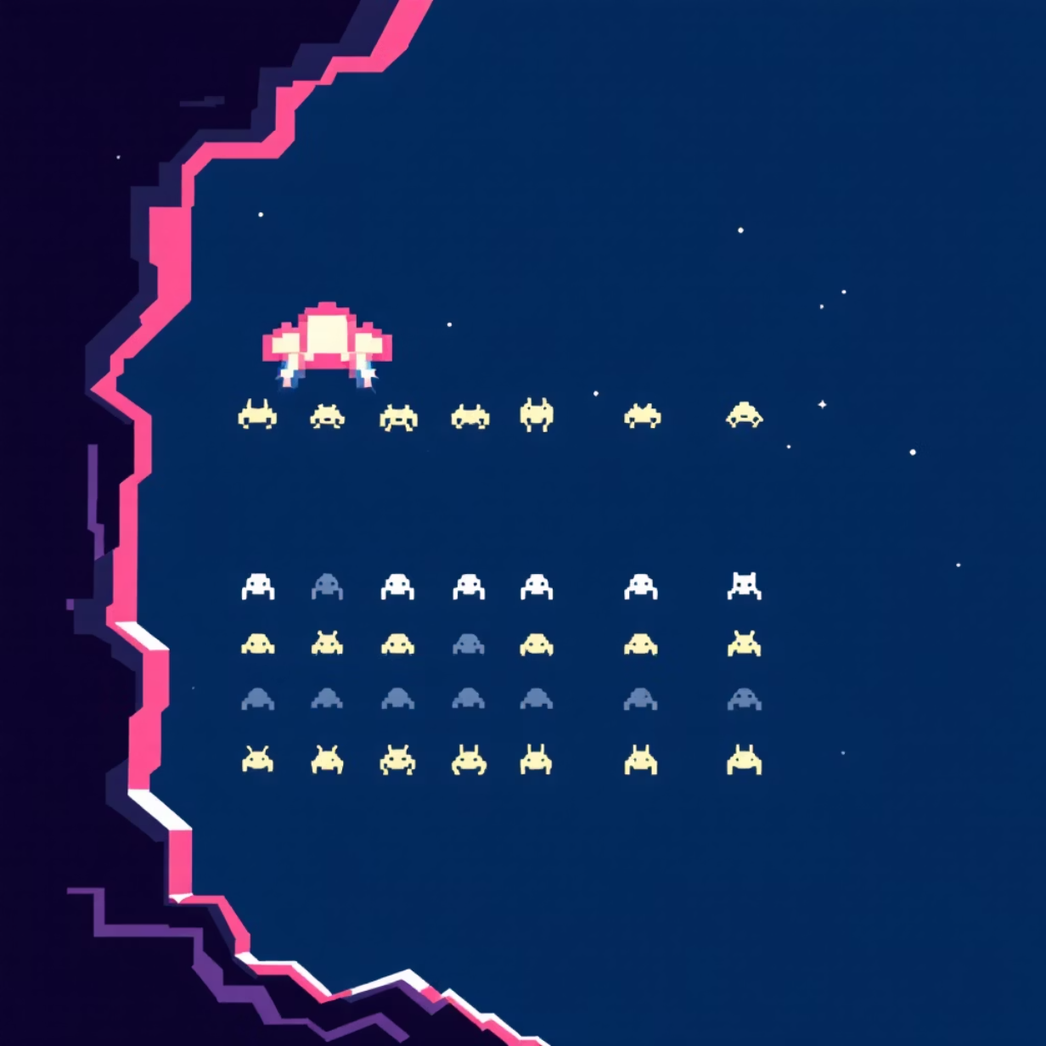
Abhinav MB — Game Engine & Logic
Feature Implementation: Developed the core game engine and main loop, ensuring smooth state transitions and event handling. Primary contribution to main.py.
Collision Logic: Implemented precise collision detection for player projectiles, enemy ships, and boundaries, crucial for accurate gameplay mechanics.

Slide 7
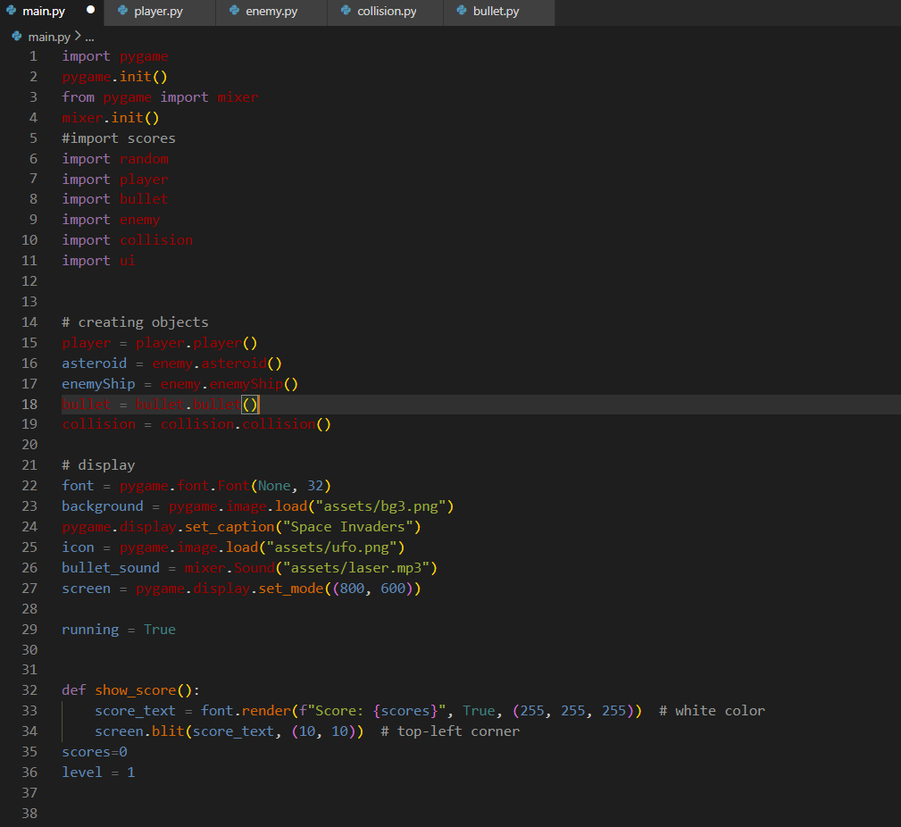

Slide 8
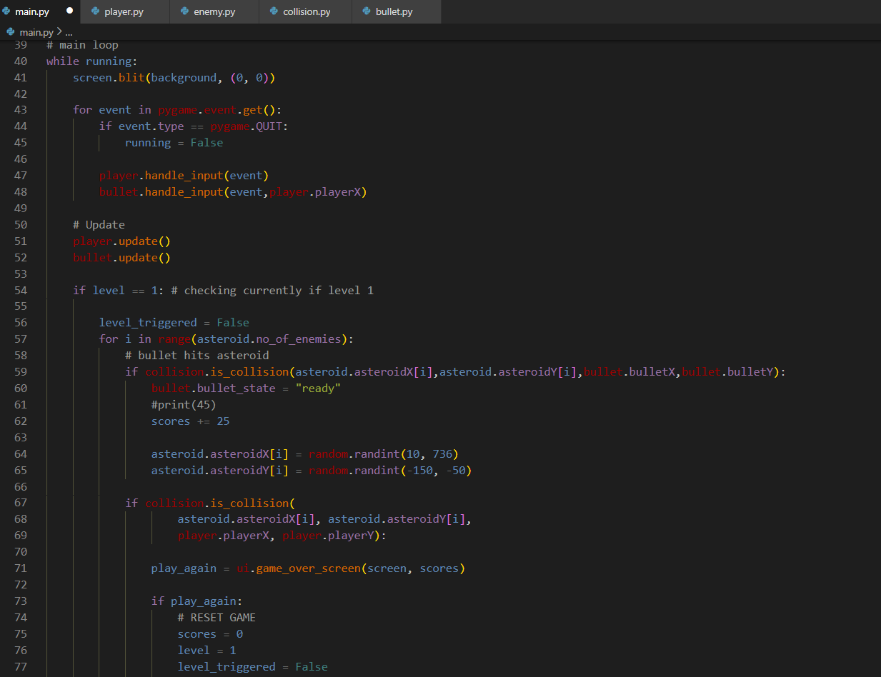

Slide 9
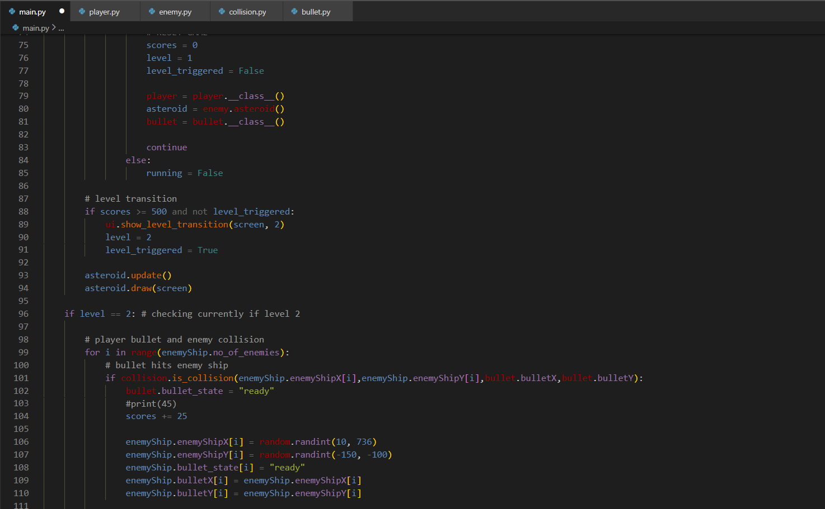

Slide 10
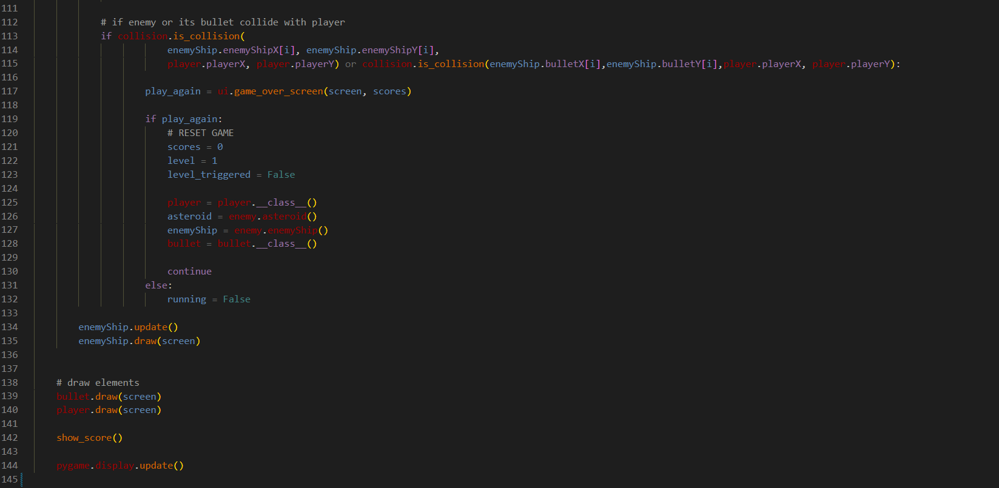

Slide 11
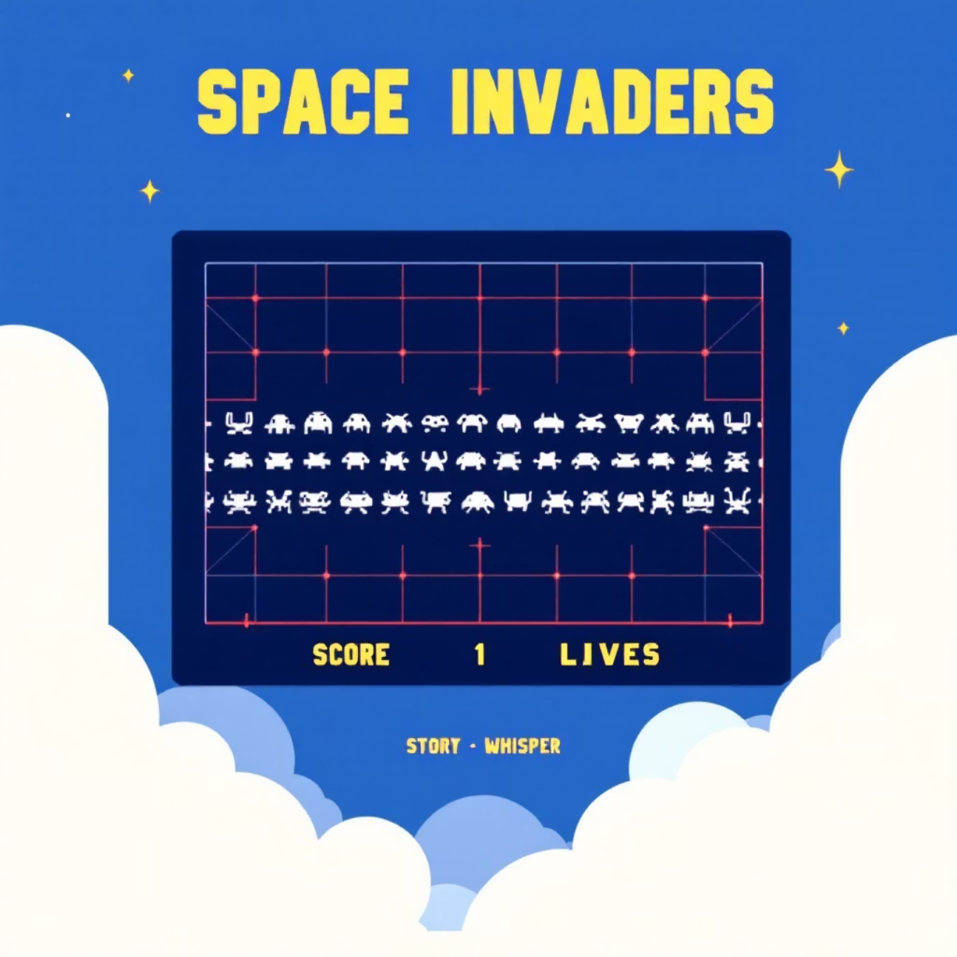
Madhusuthan V— Sprites & UI
Visual Assets: Managed and optimised all game sprites, ensuring visual consistency and efficient loading. Files primarily in the assets/ directory.
Rendering Pipeline: Constructed the game's rendering system, responsible for drawing all game elements to the screen at optimal frame rates.
User Interface (UI) & HUD: Designed and implemented the in-game heads-up display (HUD), showcasing player score, lives remaining, and other crucial game information.
Snippet: Render logic for a score update: screen.blit(font.render(f"Score: {score}", True, WHITE), (10, 10))

Slide 12
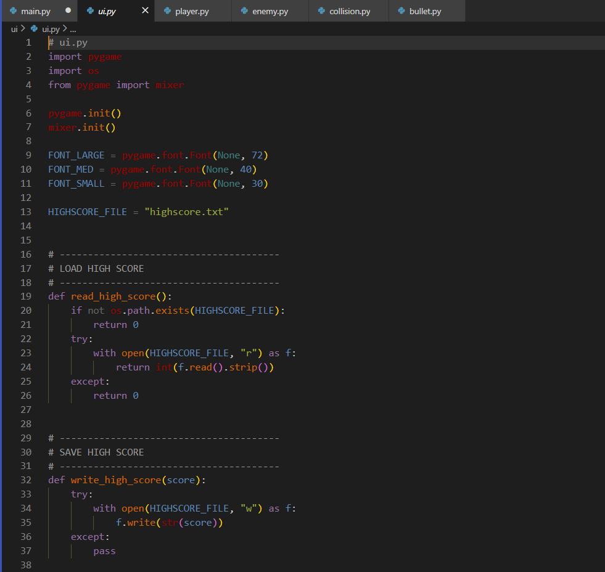

Slide 13
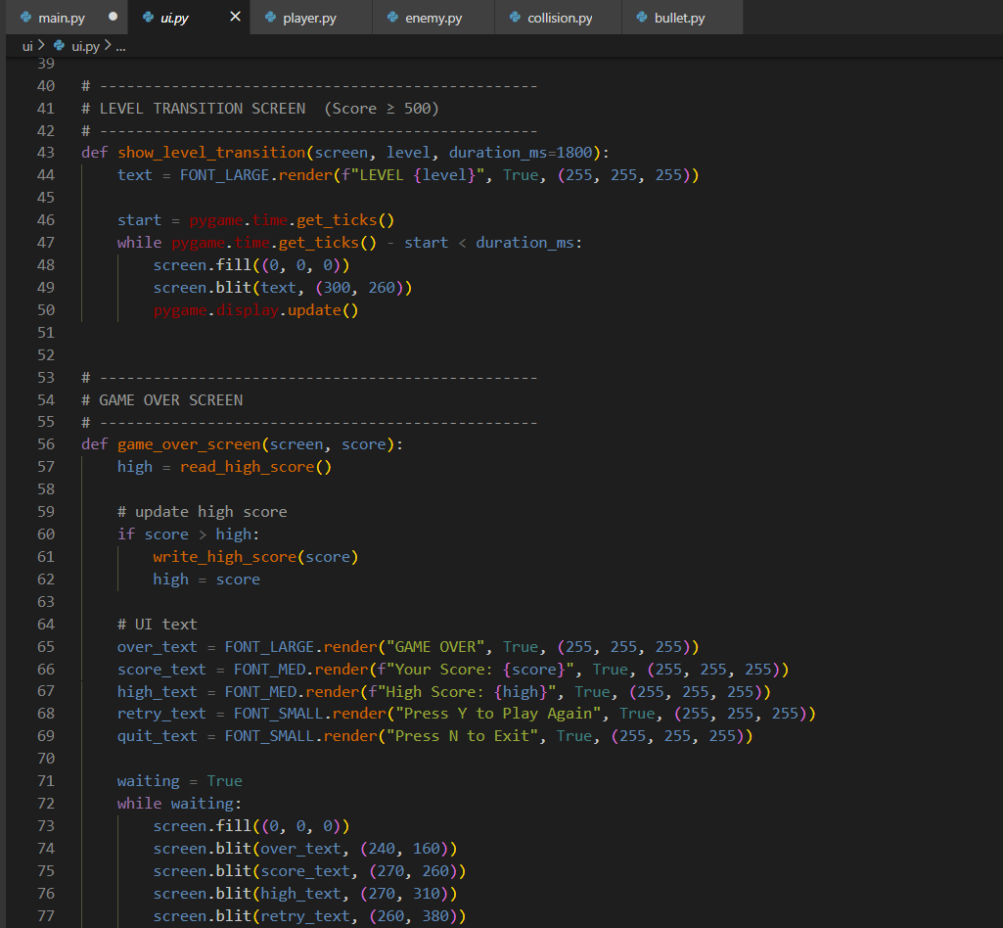

Slide 14
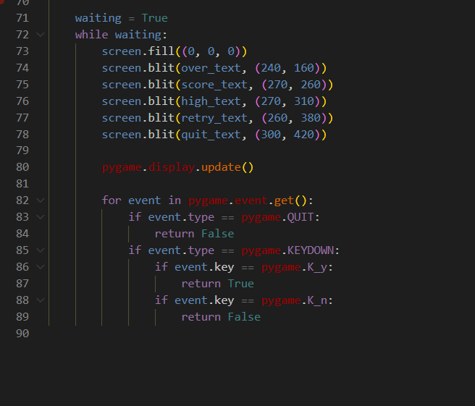

Slide 15
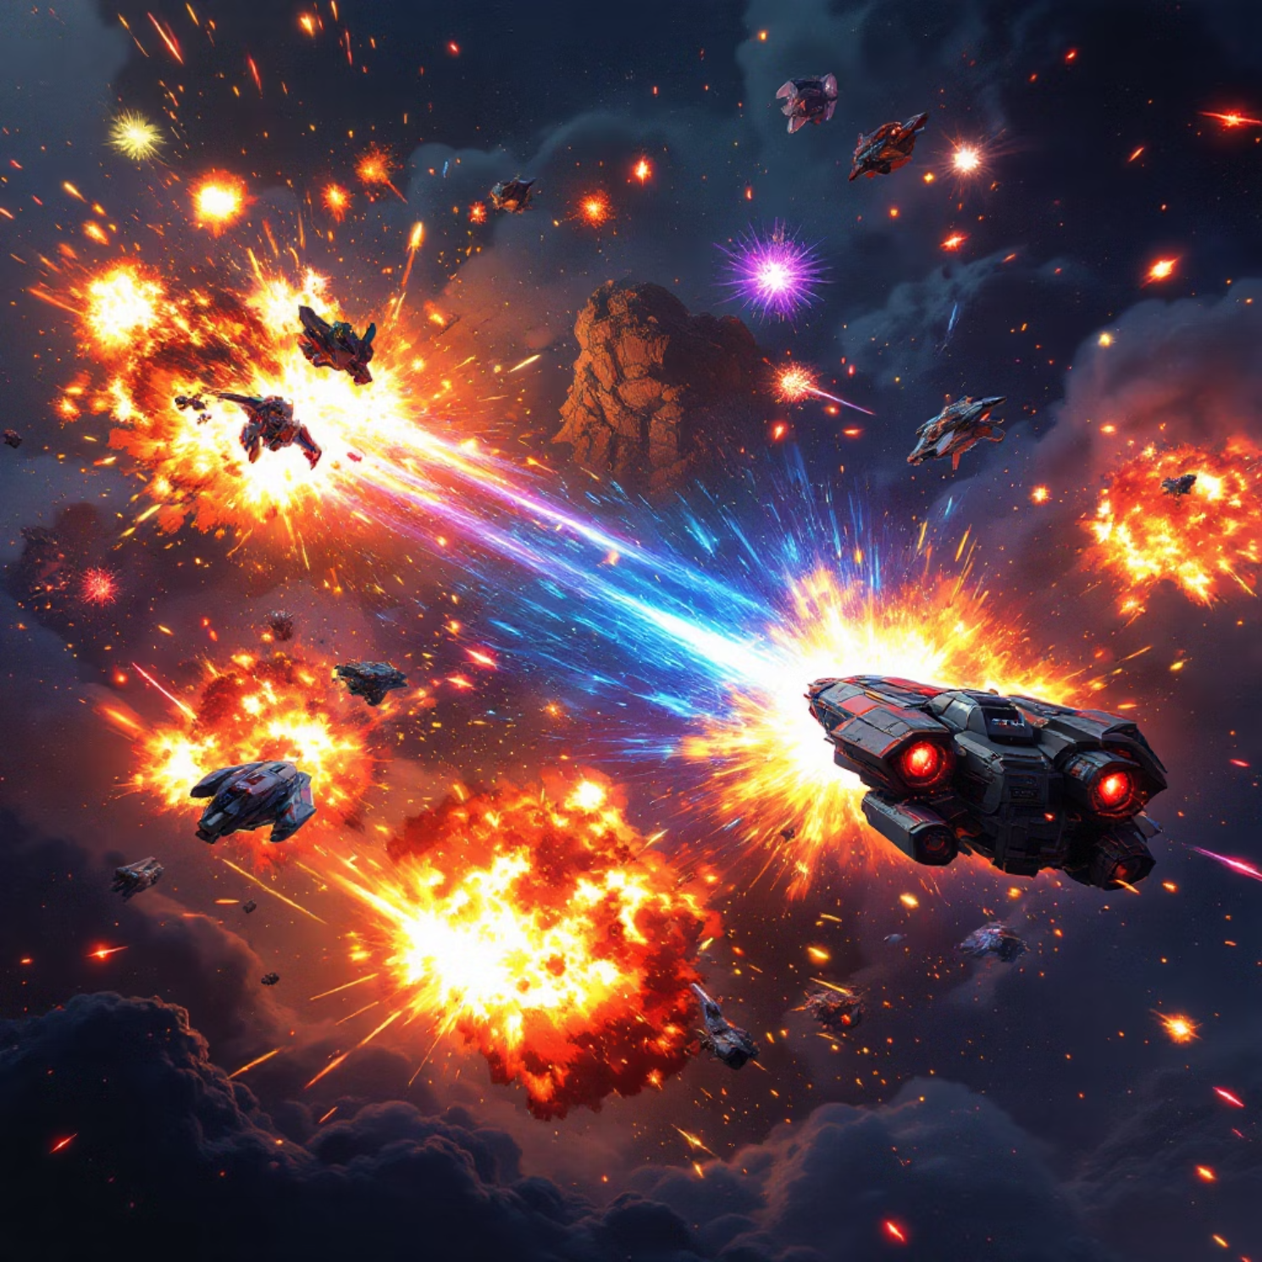
Likhit B - Collision , player , sprites
Player Logic (player.py):
Implemented player movement and input handling, ensuring responsive controls.
Collision Mechanics (collision.py):
Implemented boundary collision detection to keep game elements within screen limits.
Bullet(Bullet.py):
Handled player bullet mechanics

Slide 16
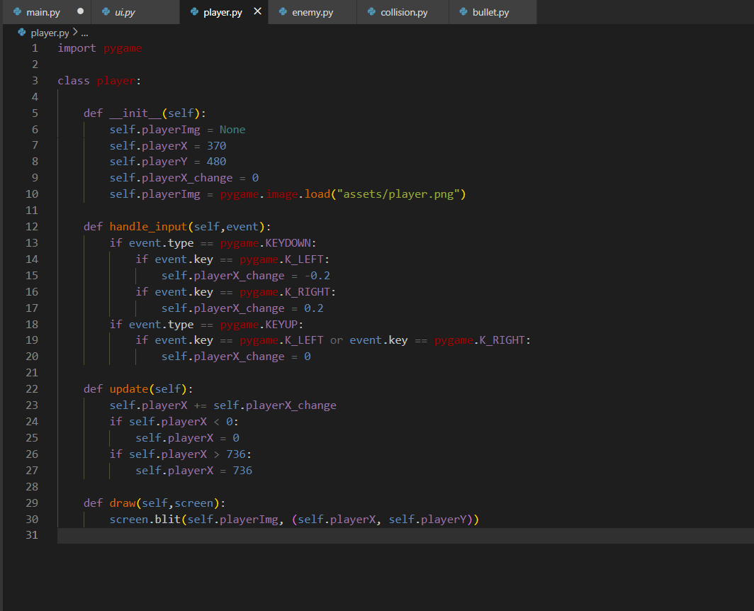

Slide 17
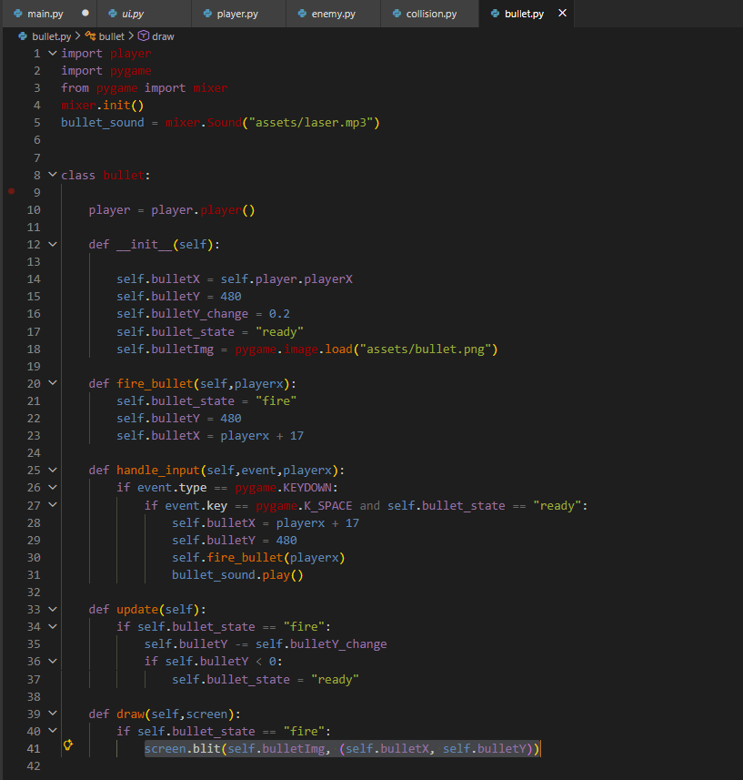

Slide 18
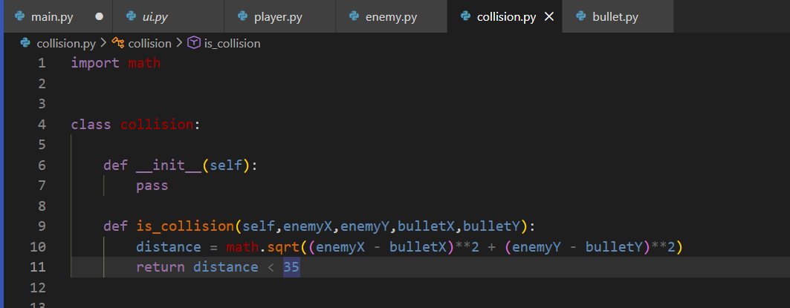

Slide 19
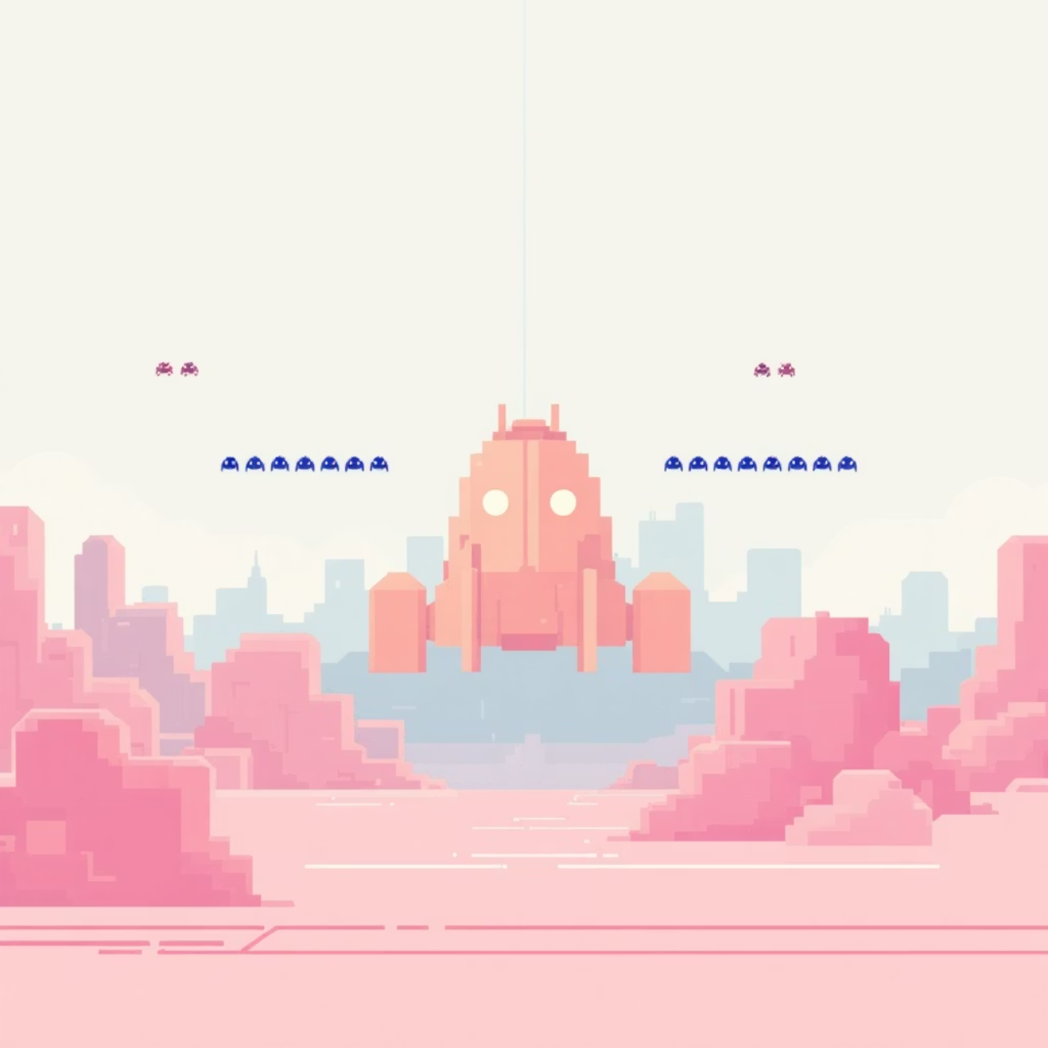
Naonith K Rao — Level Design
Level Design: Created initial game levels, defining enemy formations, spawn patterns, and wave progression.
Enemy : Developed the behaviours for various enemy types, including movement patterns, attack strategies, and evasive manoeuvres.
Challenge: Balancing enemy difficulty and player engagement without overwhelming the player, resolved through iterative testing and feedback loops.
A snippet from enemies.py for basic enemy movement: self.x += self.speed * self.direction

Slide 20
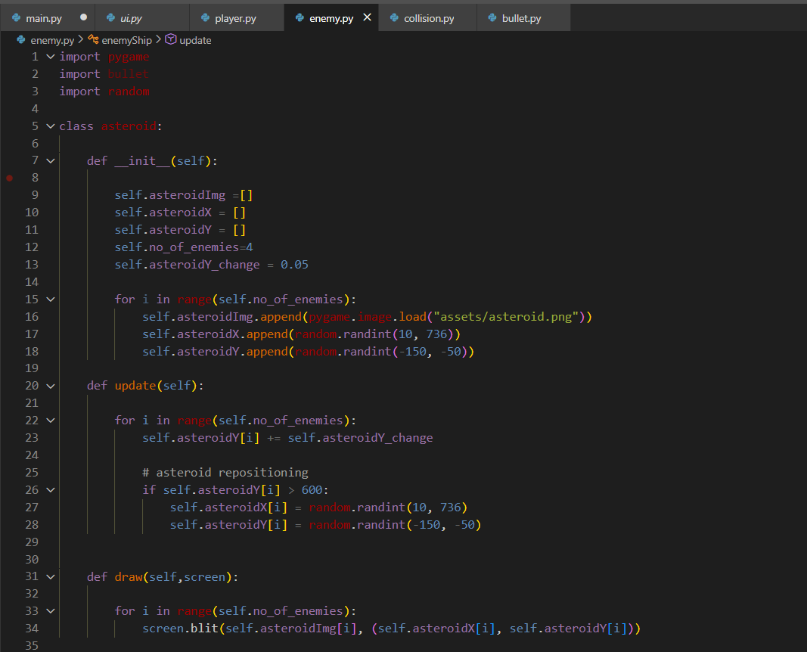

Slide 21
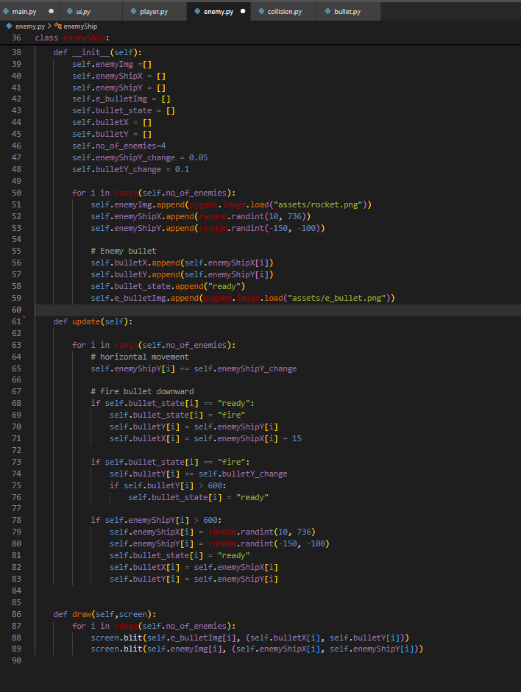

Slide 22
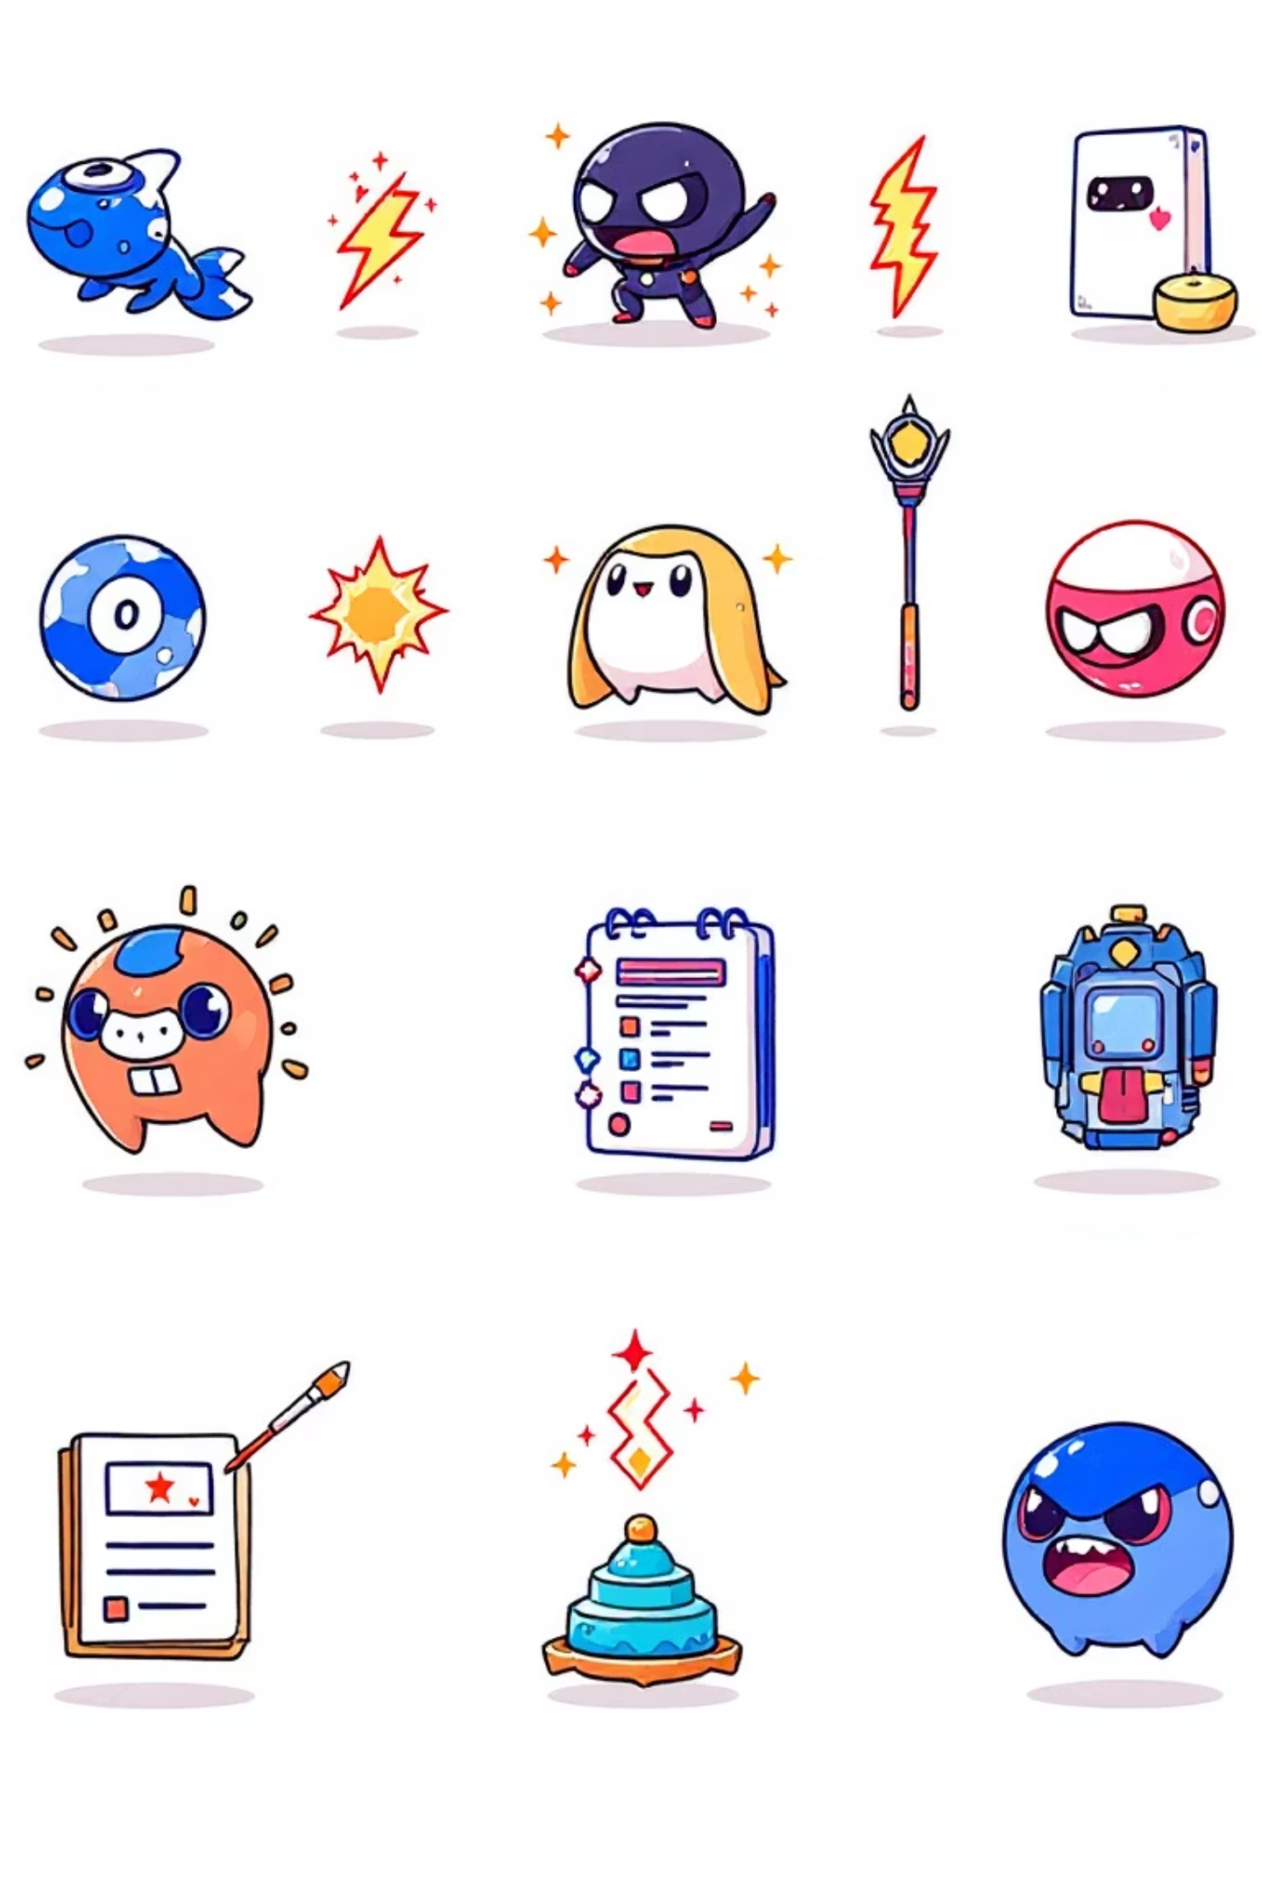
Challenges & Future Work
Technical Challenges Faced
Optimising enemy in level 2 rendering.
Ensuring consistent score display
Bullet mechanics of enemy and player
Potential Extensions
Integrating procedural level generation for endless replayability.

Slide 23
Thank You
Space Invaders!!
Project Repository: https://github.com/Abhi752007/space-invaders-project.git

